Slide 1
Esperanto SoC
Session - I
Developer: Ryan Naveed
Dated: July 30th, 2026

Slide 2

Esperanto Core-ET SoC
Open-source manycore platform
Designed by Esperanto Technologies, specifically for ML and AI computes
Acquired on November 2025 by AiNekko
Open-sourced it under the AI Foundry and OpenHW umbrella
Architectural Docs: Core-ET manuals
RTL Code: Core-ET RTL

Slide 3


Core SoC and IO Overview
1,093 total RV64 RISC-V cores
  1,088 In-Order cores (Minions) for ML computes
  (1024 cores for processing, 32 cores for task division, and the remaining 32 cores for consistent silicon yield)
  4 Out-of-Order cores (Maxions) for management tasks
  1 dedicated RISC-V service processor
IOShire subsystem integrating UART, SPI, I2c, I3C, USB, and other peripheral controllers
PCIe Shire handling an 8-lane Gen4 physical layer with two dual-mode controllers.

Slide 4
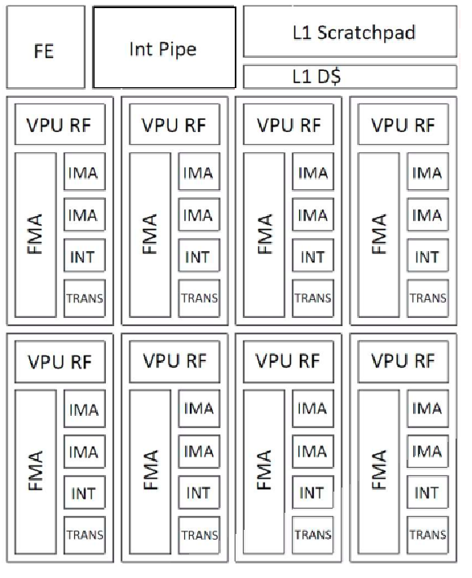
ET-Minion Core Architecture
64-bit RISC-V In-Order Processor
Supports RV64IMFC ISA Extensions
Dual Hardware Threads per Core
Single-Issue Integer Execution Pipeline
Private 4 KB L1 Data Cache
Integrated 8-Lane SIMD Vector Processing Unit (VPU)
Custom Esperanto SIMD extension

Slide 5
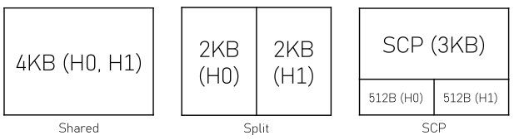
L1 - Data Cache Configuration
4KB set-associative cache size
16 sets, 4 ways, 64-bytes cache lines
Non-coherent
Configuration through mcache_control CSR
Configurable modes:

Slide 6
Vector Processing Unit (VPU)
8 identical Synchronous Lanes
32 x 256-bit Vector Registers (per thread)
TxFMA Unit – Executes one 32-bit or two 16-bit floating-point fused multiply-add operations
Dual IMA Units – Performs four 8-bit integer multiple-accumulate (MAC) operations
INT Unit – Executes Integer arithmetic and logical operations
TRANS Unit – Supports Exp2, Log2 and Reciprocal operations

Slide 7
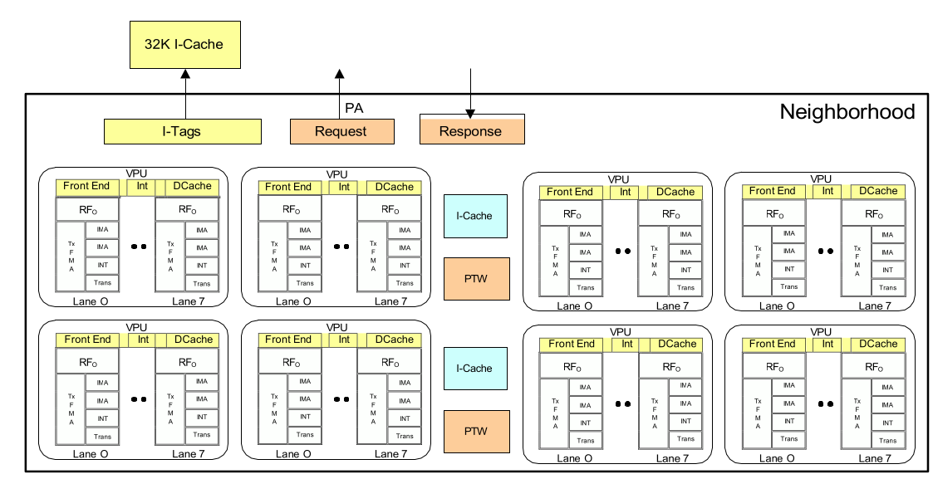
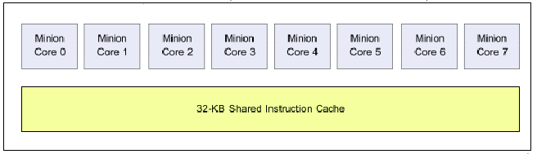
Minion Neighborhood Overview
Cluster of 8-Minion cores
32 KB shared L1 instruction cache
Dual shared L0 microcaches and PTW

Slide 8
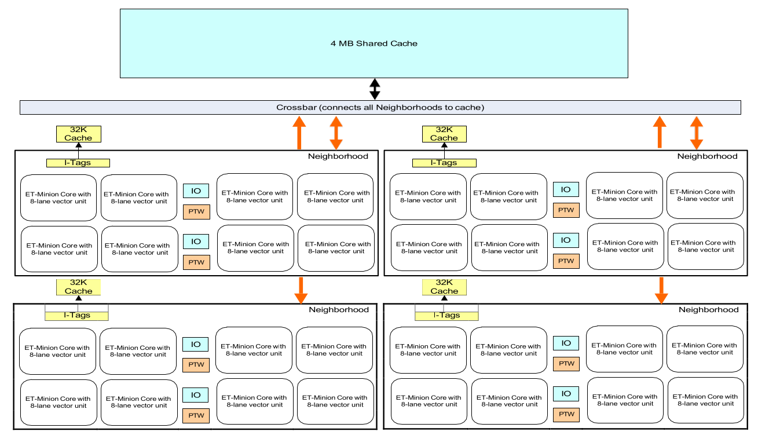
Minion Shire Hierarchy

Slide 9
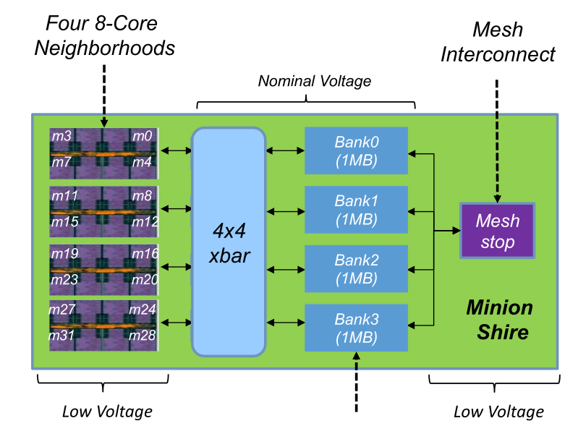
Minion Shire Overview
Cluster of 32-Minion cores
Four interconnected Neighborhoods
Integrated 4MB shared Shire Cache (L2/L3)
Integrated 4×4 crossbar for Neighborhood communication

Slide 10
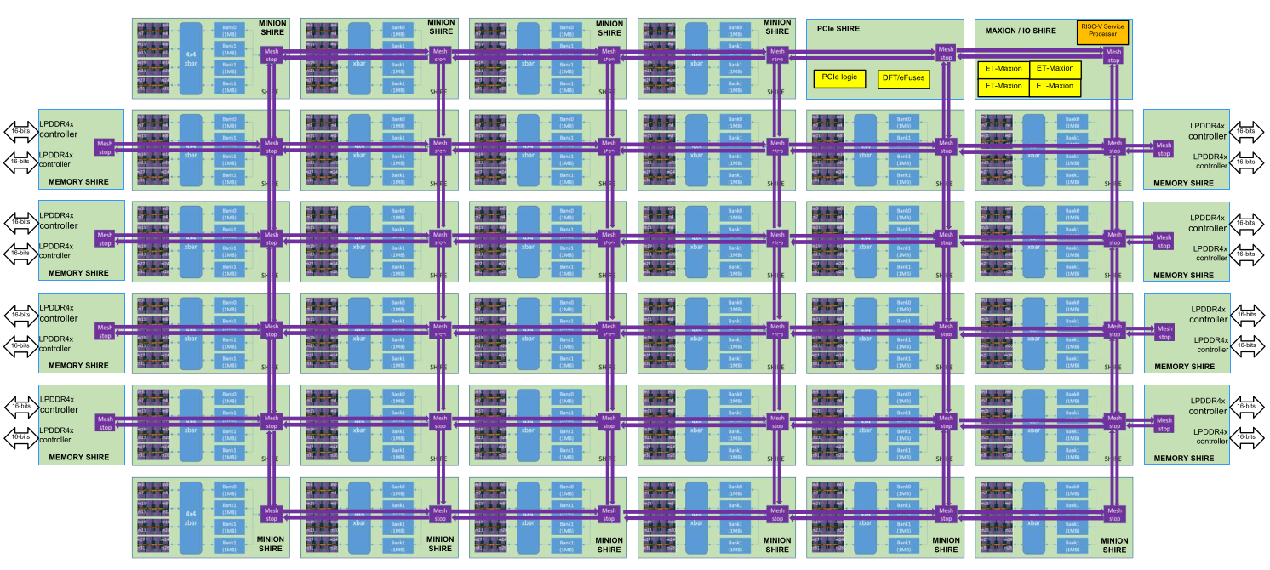
Mesh Network-on-Chip (NoC)
Top-level 8x6 grid interconnect
44-Mesh stops
Corner mesh stops are unoccupied

Slide 11
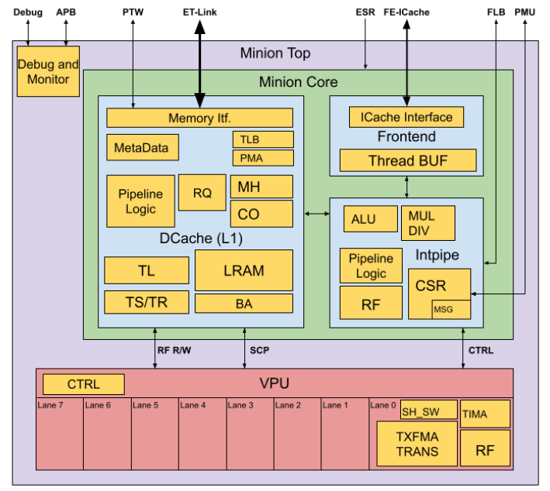
Minion Architectural Diagram
Front-End Unit for fetching and decoding instructions

Slide 12
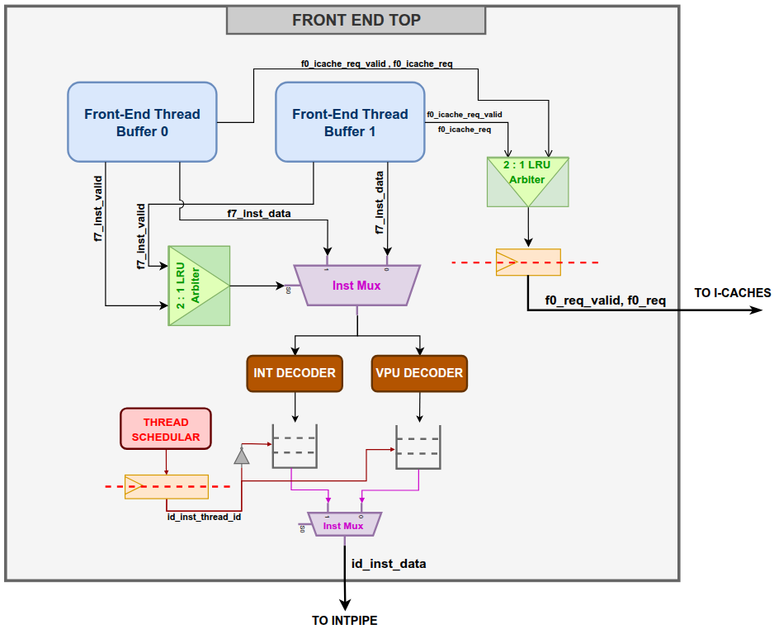
FrontEnd Unit Internal Blocks
Front-End Buffer x 2: Buffer to cache instructions from L0 u-cache.
Program Counter x 2: Separate PC for each thread (instantiated in FE Buffer).
Thread Scheduler: Schedules the thread to select the instruction to be passed to the next module (INTPIPE).
IntPipe Decoder: decodes the read instruction for the INTPIPE module.
VPU Decoder: decodes the read instruction for the VPU module.
FIFO x 2: FIFO is used to store both INTPIPE and VPU decoded signals, useful when an instruction gets fetched from the buffer during the pipeline stall.

Slide 13
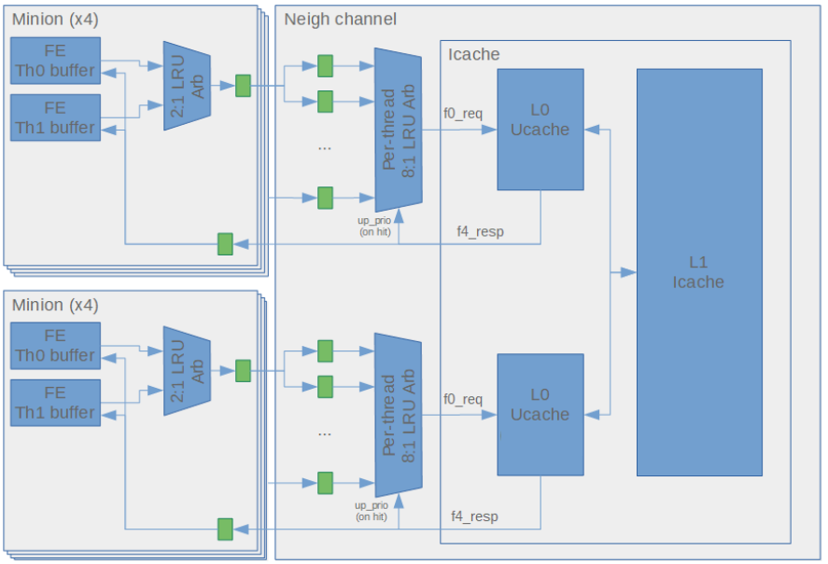
FrontEnd I-Cache Communication Interface Diagram

Slide 14
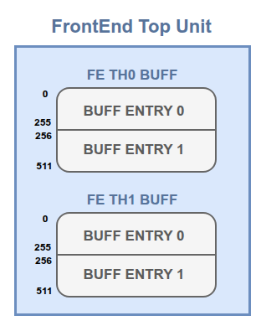
Thread FrontEnd Buffer
Each thread has its own FE buffer containing two entries each of width 256 bits.
Each entry is filled with instructions at consecutive addresses.
The read data width from the I-cache is 32 bytes (256 bits or half a cache line).
Dedicated Program Counter (PC) in each FE Buffer, tracks the next instruction to be executed for that thread.
The whole buffer gets invalidated upon receiving a new PC address from the INTPIPE, due to branch/jump instruction.In this case no instructions would get fetched until we received a valid response from L0 u-cache.
Optimizations to be made: Rather than invalidating the buffer directly, we should first determine whether the buffer contains the instructions pointing to the new address.

Slide 15
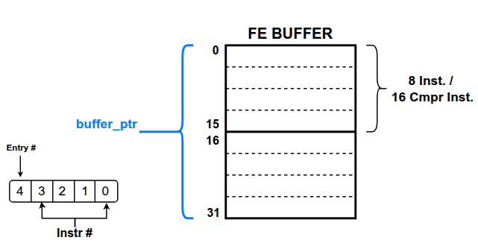
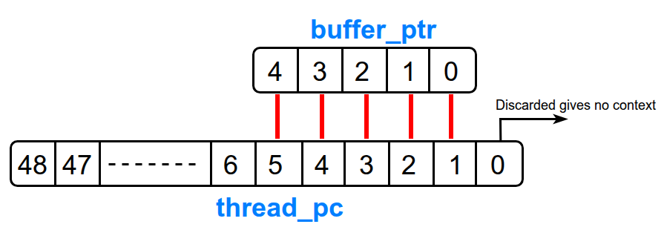
FrontEnd Buffer Instruction Fetch
Each buffer entry can hold eight general instructions or sixteen compressed instructions.
buffer_ptr reads instructions from the FE Buffer. The MSB selects the buffer entry, and the lower four bits point to a compressed instruction.
buffer_ptr value is derived from the Thread PC located in this FrontEnd Buffer. The bits (5:1) are copied in this pointer.
The fetched instruction is of 32 bits.
The instruction retrieved from the address is always of size:
buffer_ptr = (Instruction[1:0] == 2'b11)?
buffer_ptr + 2 : buffer_ptr + 1

Slide 16
FrontEnd Buffer Entry Invalidation
The entry got cleared/invalidated in 4 cases, and a new fetch request gets generated for that entry.
INTPIPE sends a new PC address in case of branch/jump or interrupts/exceptions.
PC ends with 5’h1C (decimal 28), and the instruction is not compressed.
PC ends with 5’h1E (decimal 30), and the instruction is compressed.
PC ends with 5’h1E (decimal 30), and the instruction is not compressed, and the next entry is valid.
When executing instructions from one entry, if the other is empty or invalid, generate a request in parallel to retrieve the next consecutive instructions in that entry.

Slide 17
Buffer Entry Fill Example
[m , n] represents the address of the next 8 instructions in the corresponding buffer entry. The following mechanism is used to fill the buffer entries.
Master Shire enables the minion and provides a starting address “A”.
Address A => [ x , x ]
Request sent to I-Cache
Address {A & ~0x1F} => [ A>>5 , x ]
It creates a new request since there is a free entry.
Address {(A & ~0x1F) + 32} => [ A>>5 , (A>>5)+1 ]
The entry is invalidated (for non-RVC Instruction) upon reading the final instruction from the first entry PC ({(A & ~0x1F) + 28}).
The first entry is removed => [ x , (A>>5)+1 ]
It creates a new request to I-Cache since there is once more a free entry.
Address {(A & ~0x1F) + 64} => [ (A>>5)+2 , (A>>5)+1 ]

Slide 18

Buffer Entry Fill Example
[m , n] represents the address of the next 8 instructions in the corresponding buffer entry. The following mechanism is used to fill the buffer entries.
Master Shire enables the minion and provides a starting address
Address A => [ x , x ]
Request sent to I-Cache
Address {A & ~0x1F} => [ A>>5 , x ]
It creates a new request since there is a free entry.
Address {(A & ~0x1F) + 32} => [ A>>5 , (A>>5)+1 ]
The entry is invalidated (for non-RVC Instruction) upon reading the final instruction from the first entry PC ({(A & ~0x1F) + 28}).
The first entry is removed => [ x , (A>>5)+1 ]
It creates a new request to I-Cache since there is once more a free entry.
Address {(A & ~0x1F) + 64} => [ (A>>5)+2 , (A>>5)+1 ]
Live-Lock: A single instruction infinite loop where the instruction is the last one in the cache line and the jump is repeatedly mispredicted.

Slide 19
FrontEnd Stages (8 Stages, F0 .. F7)
F0 Stage:
Handler for INTPIPE request and Thread enable/disable. I-cache requests are generated based on the INTPIPE_PC or THREAD_PC.
F1–F5 Stage:
Wait 5 cycles to receive a response from L0 u-cache.
F6 Stage:
Stores the I-cache response in FrontEnd buffer.
Read instructions from the FrontEnd buffer.
F7 Stage:
Scheduling of Threads
INTPIPE and VPU decoder
Read/Write instruction control signals FIFOs.

Slide 20
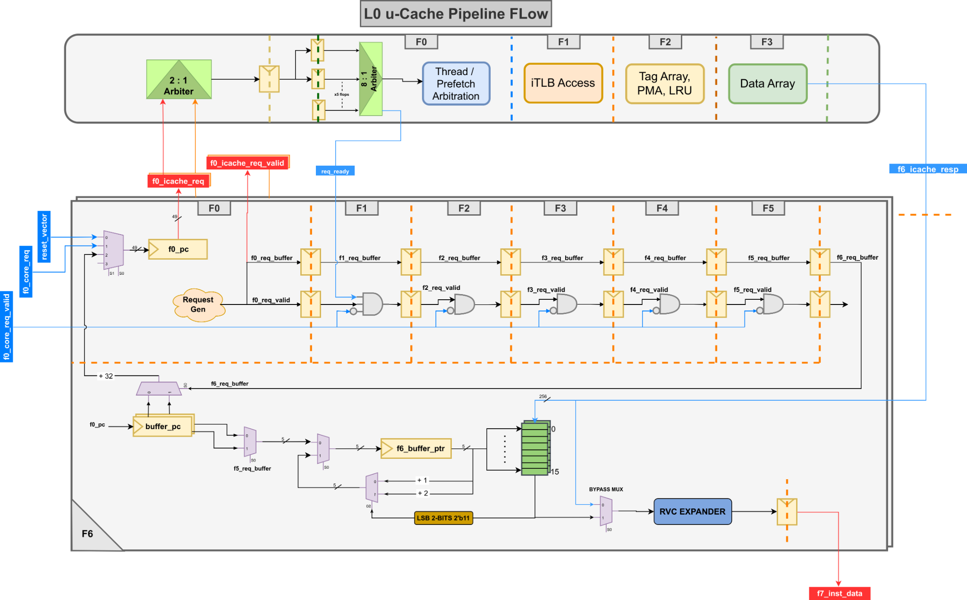
FrontEnd Stages (8 Stages, F0 .. F7)

Slide 21
FrontEnd Last Stage (Instruction Decode)

Slide 22
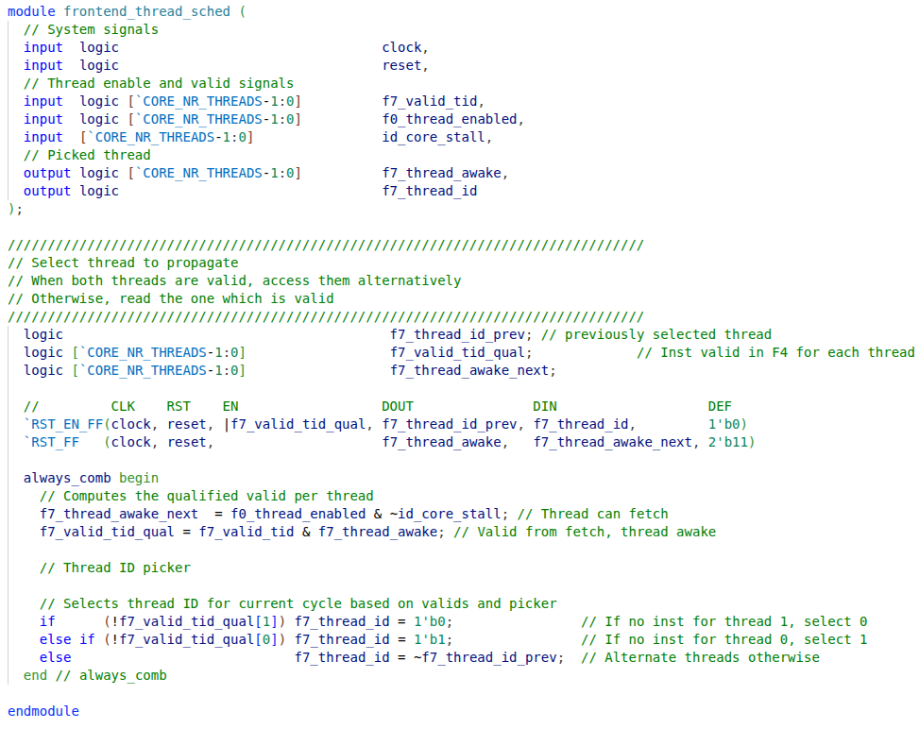
FrontEnd Thread Scheduler RTL
The scheduling is done using the Round-Robin algorithm.
If only one thread is valid, select it; if both are valid, pass the thread that wasn't selected in the previous cycle.
A thread's state is marked VALID when an instruction is read from its PC, there’s no new request from INTPIPE, and its FIFO has space.

Slide 23

FrontEnd I-Cache Communication Interface
One of the FrontEnd thread buffer requests reaches the L0 u-cache via the LRU arbiter.
After 5 cycles, the FrontEnd receives the response in both cases of HIT and MISS.
In the HIT case, the response contains instructions to be stored in the corresponding FrontEnd buffer, and the transaction is complete.
For MISS responses, the corresponding requesting thread is put to sleep, and L0 sends a fetch request to the L1 cache. Once the L1 cache responds, a "fill done" signal is sent to all minions, allowing them to wake up and retry again.
The LRU arbiter only updates the priority on the cache HIT, allowing the miss thread to retry with a higher priority when it is woken up.

Slide 24
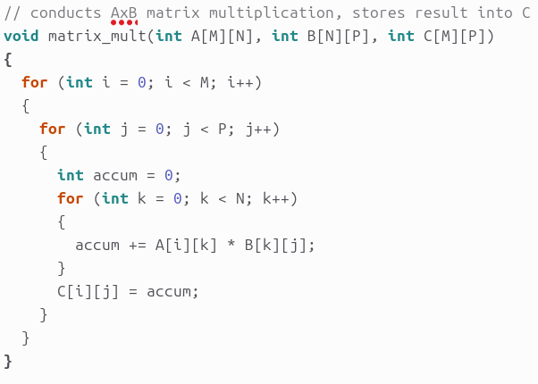
FrontEnd Issues 1 - Unnecessary Buffer Flush
We take a backward branch for this matrix multiplication code after each Multiply the operation of accumulation.
Although the prior instruction might still be accessible and might not need to be flushed for each Branch/Jump instruction, this would flush out both Buffer entries containing the instructions.

Slide 25
FrontEnd Issue 2 - Unnecessary utilization of req line
In this case, when the 2:1 arbiter grants a THREAD request for the request line, it occupies the flop until it is accepted by the next 8:1 arbiter.
This introduces unnecessary latency because we split the request to their respective flops, and the previous flop should be allocated to the other THREAD for requesting a new cache request.

Slide 26
FrontEnd Issue 3 - Waiting for the request response in case of request KILL
The Front-End Thread Buffer kills the current request when
  INTPIPE provides a new PC address due to branch/jump.
  Current request haven’t yet receveived by the L0 u-cache.
But, Instead of passing an additional Invalidate signal up to the arbiter flops, it first waits for the prior request to get accepted, ignores the granted response, and then issue a new request with the updated PC address.

Slide 27
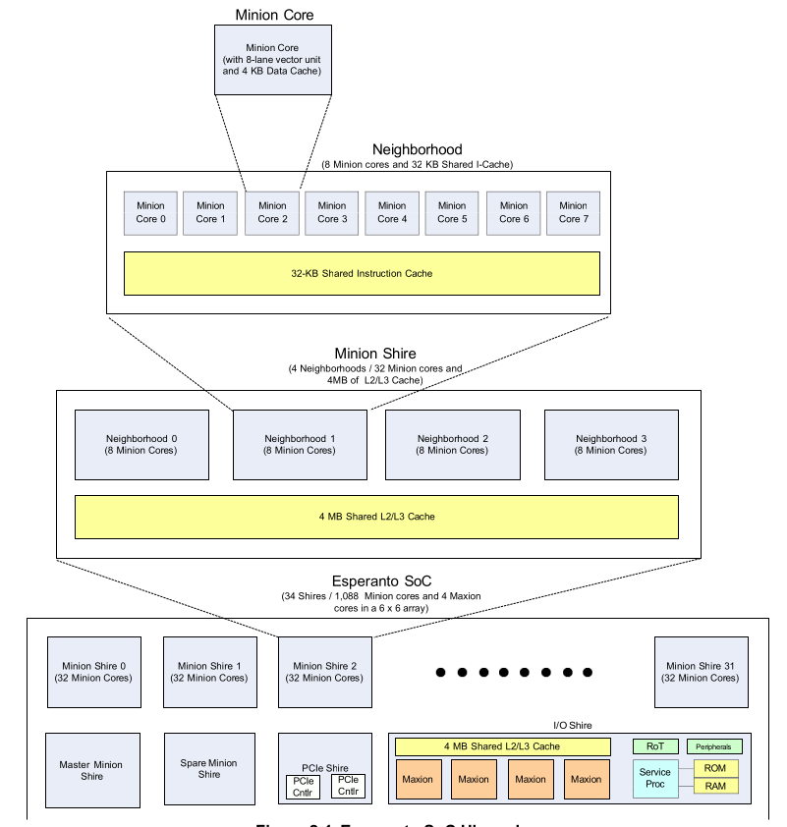
Esperanto SoC Hierarchy

Slide 28
Minion Neighborhood Overview
Cluster of 8-Minion cores
32 KB shared L1 instruction cache
Dual shared L0 microcaches and PTW

Slide 29
L0 u-cache Overview
Capacity & Structure: 16-entry, Fully Associative
Addressing: VIPT (Virtually Indexed, Physically Tagged)
Pipeline: 5-stage non-blocking (F0–F4) latency
Instances: 2x L0 Micro-caches per Neighborhood
Service: Shared by 4 Minions (8 Threads)
Bypass Capability: Supports a bypass path that allows instruction fetches to be serviced directly from the L1 I-Cache without allocating the data into the L0 u-cache.
Software-Controlled Prefetching: Provides a software-controlled prefetch mechanism capable of preloading up to 64 consecutive cache lines into the L1 I-Cache.
.

Slide 30
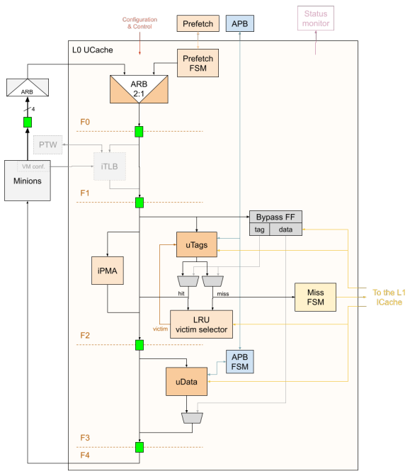
L0 u-cache Internal Blocks
iTLB: 16-entry virtual-to-physical address translation cache (2 entries/thread).
µTags: Stores tags for all 16 L0 Micro-cache entries.
iPMA: Validates physical address access attributes.
LRU Victim Selector: Selects replacement way and updates LRU on hits, misses, and L1 fills.
µData: Stores 16 cache lines, 64 bytes per line

Slide 31
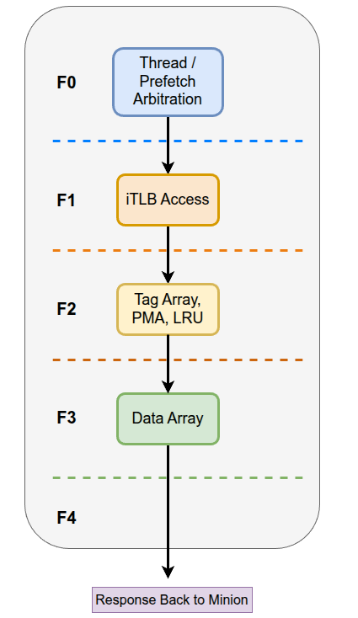
L0 u-cache Five Pipeline Stages
F0 Stage: Arbitration and Request selection
F1 Stage: Address Translation (TLB Lookup)
F2 Stage: Tag Lookup, PMA check and LRU Update.
F3 Stage: Data Array access.
F4 Stage: Response back to Minion.

Slide 32
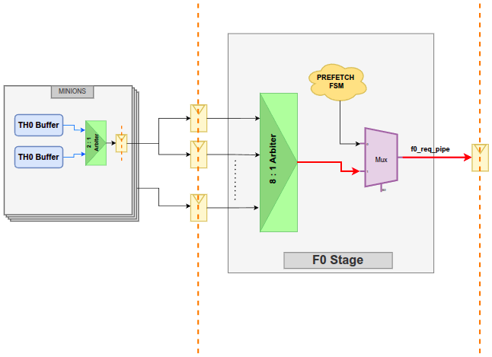
L0 u-Cache HIT Flow: Cycle 0 Arbitration

Slide 33
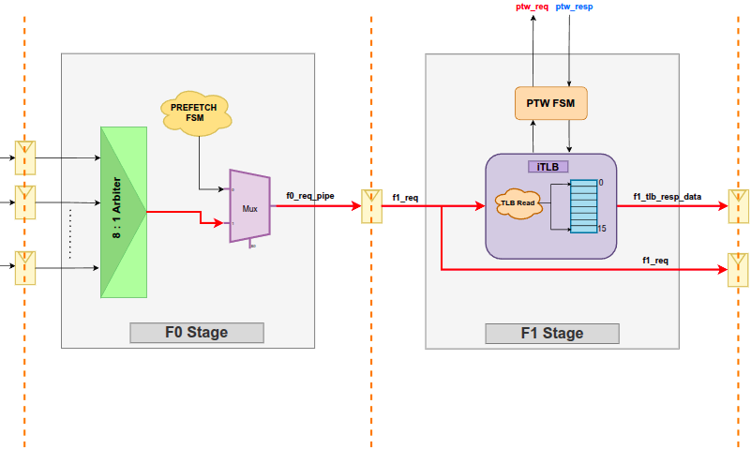
L0 u-Cache HIT Flow: Cycle 1 TLB Lookup Up

Slide 34
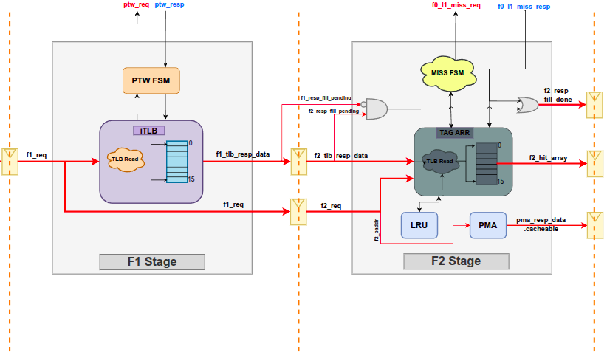
L0 u-Cache HIT Flow: Cycle 2 TAG, PMA, LRU

Slide 35
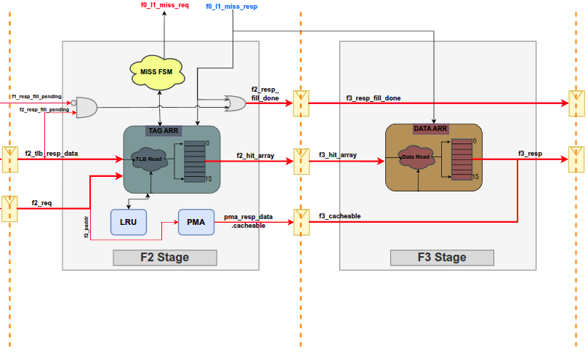
L0 u-Cache HIT Flow: Cycle 3 Data Access

Slide 36
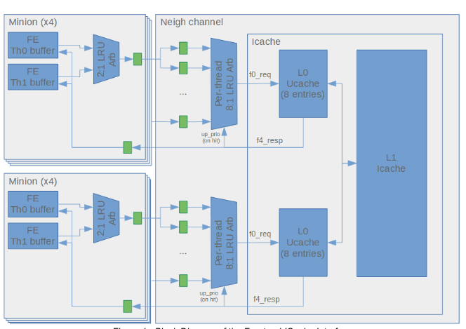
L0 u-Cache HIT Flow: Cycle 4 Update Arbiter LRU
If the “f4_resp” is HIT, then the arbiter updates the LRU policy of that thread.
No updation would be made for cache miss response

Slide 37
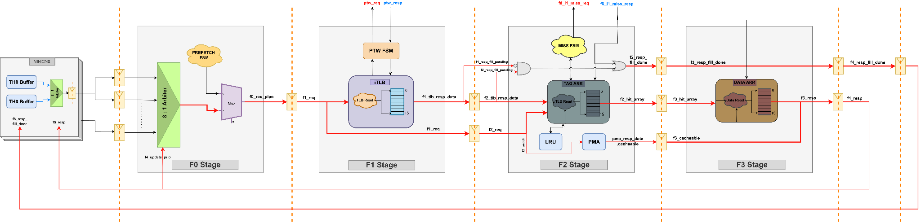
L0 u-Cache Response Complete Flow:

Slide 38
TLB Miss Handling
Cycle | Operation
F0 | Arbitration selects the thread request.
F1 | TLB lookup. On a miss, a PTW request is generated immediately and tlb_fill_pending is asserted
F2 – F3 | If tlb_fill_pending remains asserted, the miss response continues through the pipeline.
F3 – F4 | The requesting thread receives a MISS response and transitions to the sleep state.
PTW request is issued immediately upon TLB miss.
The lookup pipeline is not stalled.
The miss response follows the normal 5-stage latency.
The requesting thread sleeps after receiving the miss response.

Slide 39
TLB Fill Completion & Thread Wake-up
PTW Response Flow
PTW returns the translated address.
TLB entry is updated.
tlb_fill_pending is cleared.
resp_fill_done is generated.
resp_fill_done propagates to the 6th stage.
Sleeping threads wake up and retry their requests.
resp_fill_done is intentionally delayed until the 6th stage to prevent overlap between the sleep and wake-up events.

Slide 40
TAG Array Miss Flow
Cycle | Operation
F0 | Arbitration
F1 | TLB lookup (Hit)
F2 | Tag Array lookup (Miss) and L1 I-Cache request generated
F3 – F4 | Miss response propagates through the pipeline. Requesting thread receives MISS response and enters sleep.

Slide 41
L1 I-Cache response & Thread Wake-up
I-Cache Response Flow
L1 I-Cache returns the requested cache line.
Tag Array and Data Array are updated.
resp_fill_done is generated and propagated to the 6th stage.
Sleeping threads wake up and retry and again go to sleep if the repsonse fill is not relevant to that thread.
Note:
resp_fill_done and l0_cache_response are common for all 8 threads.
The normal response (resp) is also observed by all threads, with each thread acting only on the response intended for it.

Slide 42
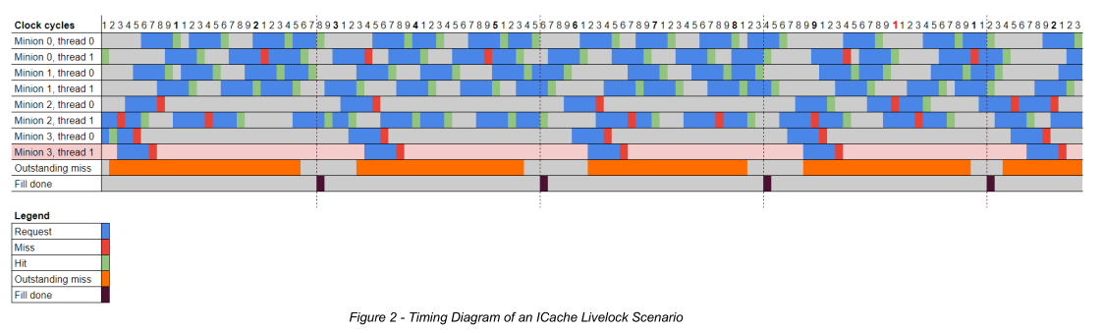
Live-Lock Timing Diagram

Slide 43
Software Pre-Fetch Mechanism
The NORTH L0 micro-cache includes a software-controlled prefetch engine.
Prefetch requests target the L1 I-Cache.
A single prefetch operation can fetch up to 64 consecutive cache lines.
Prefetching begins when the esr_prefetch_start signal is asserted.
If a new esr_prefetch_start request arrives while a previous prefetch sequence is still active, then the current prefetch operation is aborted, and the FSM immediately starts the new prefetch sequence.
During the prefetch all requests would intentionally get missed, and the L1 I-cache response would not be cached.

Slide 44
Software Pre-Fetch FSM
State | Operation
IDLE | Waiting for esr_prefetch_start.
REQUEST | Generates the next prefetch request when no thread request is pending.
CHECK_HIT | TLB LookUp to obtain the Physical address
FILL_WAIT | Waiting for the L1 I-Cache to return resp_valid
FILLDONE_WAIT | Waiting for resp_fill_done before issuing the next prefetch.
PREREQ_PAUSE | Waits for 8 cycles before issuing the next prefetch request.

Slide 45
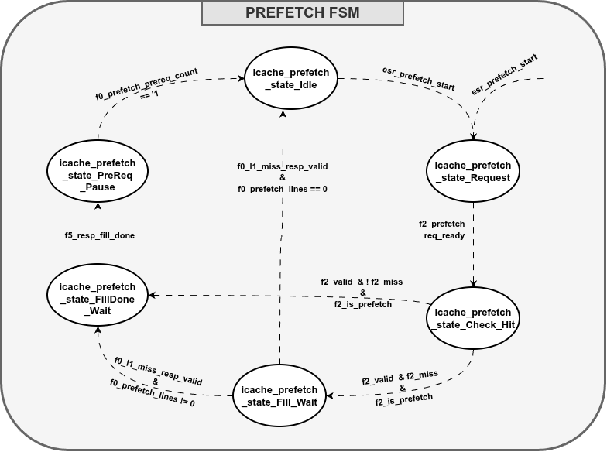
Software Pre-Fetch FSM

